Slide 1
Lecture 24
Referencing
Notes:
Students in pairs discuss their ideas of plagiarism. Feedback from students and discussion.

Slide 2
Harvard Referencing System (Journal Article)
In text:
(Author’s surname, Year, Page number if required)
E.g. (Guthrie, Petty & Ricceri, 2006, p. 256)
Reference list:
Author’s surname, First initial (Year) ‘Title of article’, Name of Journal, volume, number, range of pages.
E.g. Guthrie, J, Petty, R & Ricceri, F (2006), ’The voluntary reporting of intellectual capital. Comparing evidence from Hong Kong and Australia’, Journal of Intellectual Capital, vol. 7, no. 2, pp.254-271.

Slide 3
Harvard Referencing System (books)
In text:
(Author’s surname, Year, Page number if required)
E.g. (Watts & Zimmerman, 2006, p. 61)
Reference list:
Author’s surname, First initial, (Year), Name of book, Publisher, Place of Publication.
E.g. Watts, R & Zimmerman, J, (2006), Positive Accounting Theory, Prentice-Hall, Englewood Cliffs, NJ.

Slide 4
Quote
Because ‘[t]he annual report is the most efficient way for an organisation to communicate with those stakeholder groups deemed to have an interest in controlling certain strategic aspects of an organisation’ (Guthrie, Petty & Ricceri, 2006, p. 256), it is critical that….

Slide 5
Paraphrase
In communicating with stakeholders interested in exerting influence in areas of strategy, the annual report serves as the best means for the organisation to achieve this (Guthrie, Petty & Ricceri, 2006, p. 256).

Slide 6
Quote or paraphrase across two pages
The industry classifications used in the Hong Kong study consisted of: ‘consolidated enterprises, finance, hotels, general industry, property, utilities and growth enterprise’ (Guthrie, Petty & Ricceri, 2006, pp. 262-263).

Slide 7
Summary
Guthrie, Petty and Ricceri (2006) explain how the stakeholder and legitimacy theories make use of content analysis, such as in relation to annual reports.

Slide 8
Statistical information
This was based on information from the financial year ending 30 June 1998 (Guthrie, Petty & Ricceri, 2006, p. 258).

Slide 9
Secondary Reference
When you use author A’s work that is cited in author B, both authors are cited in-text.
A student might write the following:
E.g. The ethical branch of the stakeholder theory argues that all stakeholders must be treated fairly, no matter their level of power (Deegan, 2000 in Guthrie et al., 2006, p. 256).
Only author B is acknowledged in the reference list:
E.g. Guthrie, J, Petty, R & Ricceri, F (2006), ’The voluntary reporting of intellectual capital. Comparing evidence from Hong Kong and Australia’, Journal of Intellectual Capital, vol. 7, no. 2, pp.254-271.

Slide 10
When is the page number required in the in text reference?
Specific information from a specific page
Specific information from across two pages
Statistics/ diagrams/ tables

Slide 11
Referencing Government or Standards Publications
Due to differences in form/publisher, sometimes additional relevant details are required to ‘pinpoint’ location of information:
In text:
(AASB, 2007, AASB 2, para. 19)
Reference list:
AASB (Australian Accounting Standards Board), 2007, AASB 2 Share-based Payments, AASB, Canberra, viewed 7 May 2008 <http://www.aasb.com.au>.

Slide 12
Which should you rely on most: quoting or paraphrasing? Why?
Paraphrasing
- shows understanding of what you have read
- allows integration of source information into your own argument more easily
Quoting – use only if:
- paraphrasing causes misinterpretation
- analysing the quote itself is important
- exact words from the source are particularly forceful

Slide 13
Common errors in referencing
No reference provided where necessary
Reference provided where not necessary
Incorrect source provided as reference
Quotation marks not used where necessary

Slide 14
Common errors in referencing (cont’d)
Page numbers not included where necessary
Incorrect page numbers given
Use of page number instead of paragraph number in references to Government or Standards publications
Misspelling
Incorrect/inconsistent punctuation

Slide 15
Placement of in text reference
After specific information in part of sentence or at end of sentence.
When reading, look for language structures associated with use of sources:
  X is considered a component of…;
  Y is claimed to be…
  The term Z refers to…
  Several studies have revealed that…

Slide 16
How to avoid plagiarism
Read like a writer
Take note of sources while researching
Paraphrase while taking notes
Reference appropriately
Manage time

Slide 17
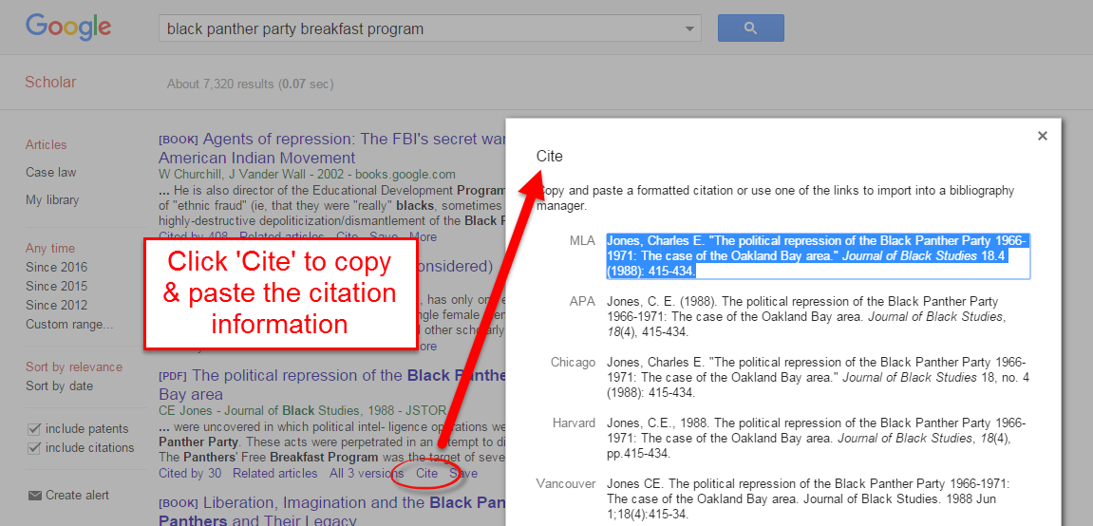
CITE Information

Slide 18
Summary
Introduction of Plagiarism
Types of plagiarism
Implications of plagiarism
Referencing
Types of Referencing
Style of referencing

